Slide 1
FURPS+

Slide 2
Hvad er FURPS+ ?
FURPS+ er god som en tjekliste for dæknings krav, for at reducer risicien for at man glemmer nogle vigtige implementeringer i systemet
Der to slags krav
Funktionelle (opførelse)
Ikke-funktionelle krav (alt det andet)

Slide 3
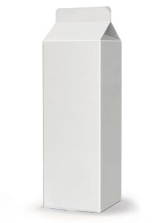
F = Functional
Features, capabilities, security

Slide 4
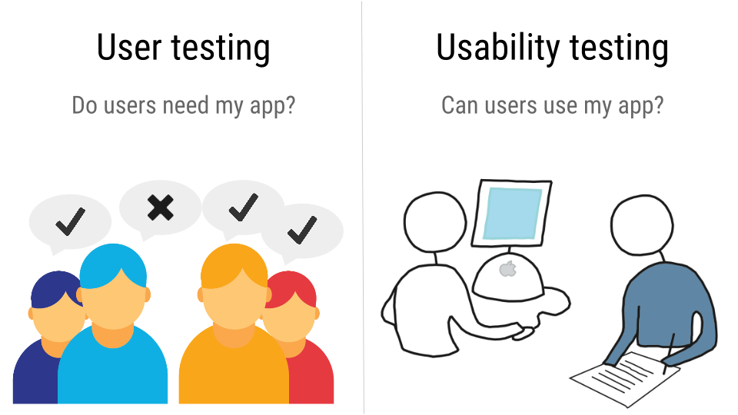
U = Usability
Human factors, help, documentation

Slide 5
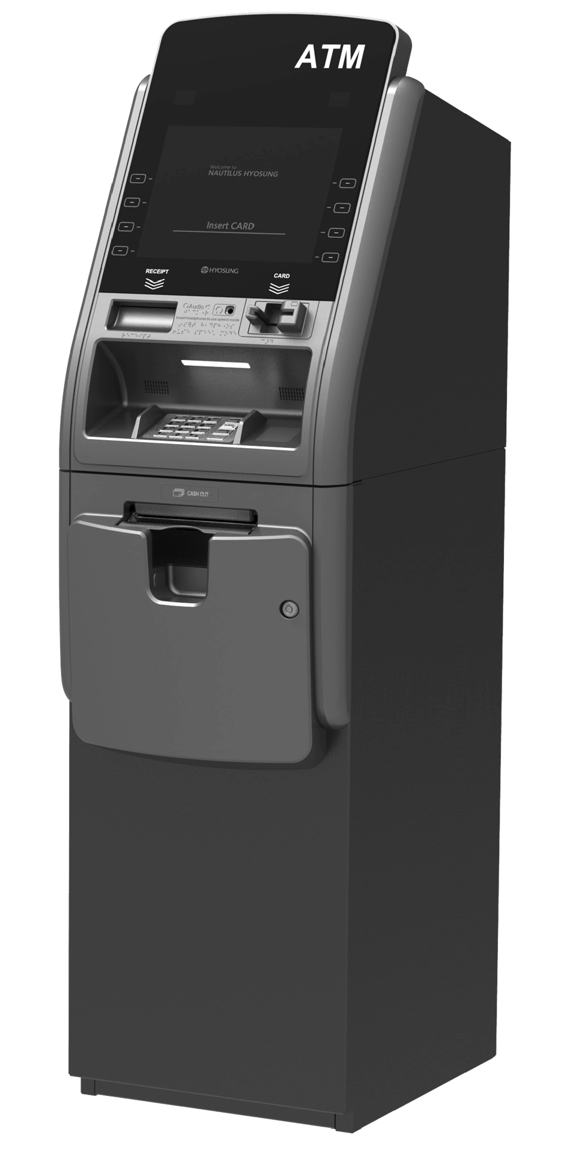
R = Reliability
Frequency of failure, recoverability, predictability

Slide 6

P = performance
Response times, throughput, accuracy, availability, resource usage.

Slide 7

S = Supportability
adaptability, maintainability, internationalization, configurability

Slide 8
= Implementation, Interface, Operations, Packing, Legal
Implementation: resource limitations, languages and tools, hardware,...
Interface: constraints imposed by interface with external systems.
Operations: system management in its operational setting.
Packing: for example, a physical box.
Legal: licensing and so forth

Slide 9
